Slide 1
Insertion sort
BY AYNUR NAZARLI

Slide 2
What is insertion sort?
Insertion sort is a simple sorting algorithm that works by iteratively inserting each element of an unsorted list into its correct position in a sorted portion of the list. It is a stable sorting algorithm, meaning that elements with equal values maintain their relative order in the sorted output.
Insertion sort is like sorting playing cards in your hands. You split the cards into two groups: the sorted cards and the unsorted cards. Then, you pick a card from the unsorted group and put it in the right place in the sorted group.

Slide 3
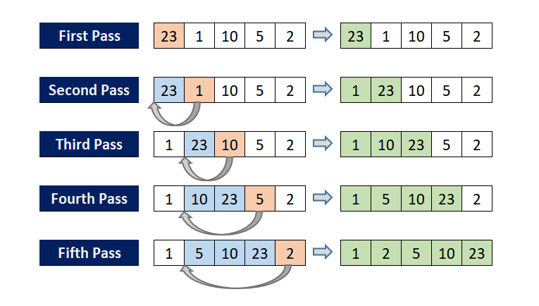
Insertion sort algorithm

Slide 4
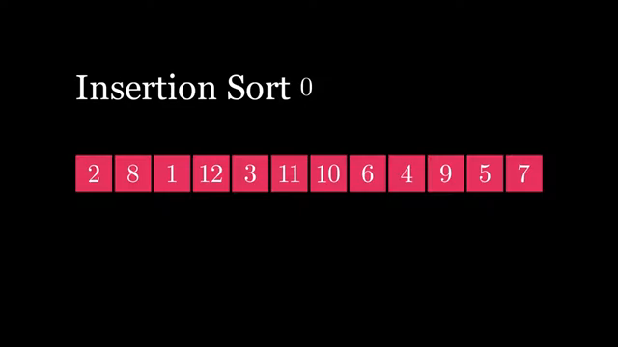

Slide 5
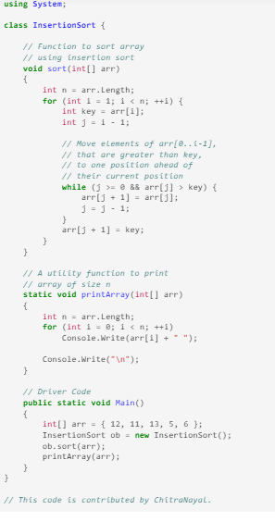
Implementation of insertion sort
Step 1 - If the element is the first element, assume that it is already sorted. Return 1.
Step2 - Pick the next element, and store it separately in a key.
Step3 - Now, compare the key with all elements in the sorted array.
Step 4 - If the element in the sorted array is smaller than the current element, then move to the next element. Else, shift greater elements in the array towards the right.
Step 5 - Insert the value.
Step 6 - Repeat until the array is sorted.

